Slide 1



Personalized Trip Planner with AI
Author: la**05@gmail.com
Created with Pi

Slide 2

CONTENTS
1. Team Information
2. Solution Overview
3. Unique Selling Proposition
4. Features of the Solution
5. Project Documentation
6. Technologies Used in the Solution
7. Implementation Cost Estimate
8. Additional Requirements for the Hackathon

Slide 3

01
Team Information

Slide 4

Team Name and Leader
Team Name:
Team Leader Name: YUVRAJ SINGH RATHORE
Problem Statement
Problem Statement: “Personalized Trip Planner with AI.”

Slide 5

02
Solution Overview

Slide 6

AI-Powered Personalized Trip Planner
An AI assistant that designs end-to-end personalized travel itineraries.
Users input budget, dates, interests, group size, and preferences.
System recommends destinations, hotels, transport, and activities.
Delivers a custom day-wise plan with dynamic updates.
Integrated with EaseMyTrip APIs + Google Cloud AI tools.

Slide 7

03
Unique Selling Proposition

Slide 8


Unique Selling Proposition
Differentiation from Existing Solutions
Problem Solving
Unique Selling Points (USP)
• Saves travelers’ time by automatically creating a personalized, optimized plan.
• Conversational AI Travel Buddy (chatbot powered by Google Cloud AI).
• Existing travel platforms only provide static search results (flights/hotels).
• Personalized recommendations + itinerary generation in one place.
• Reduces decision fatigue by providing curated options based on user profile.
• Our solution uses Gen AI + ML to generate customized itineraries and adjust them dynamically.
• Seamless integration with EaseMyTrip booking ecosystem.
• Provides real-time adaptability (e.g., “extend trip by 2 days”, “reduce budget”).

Slide 9

04
Features of the Solution

Slide 10
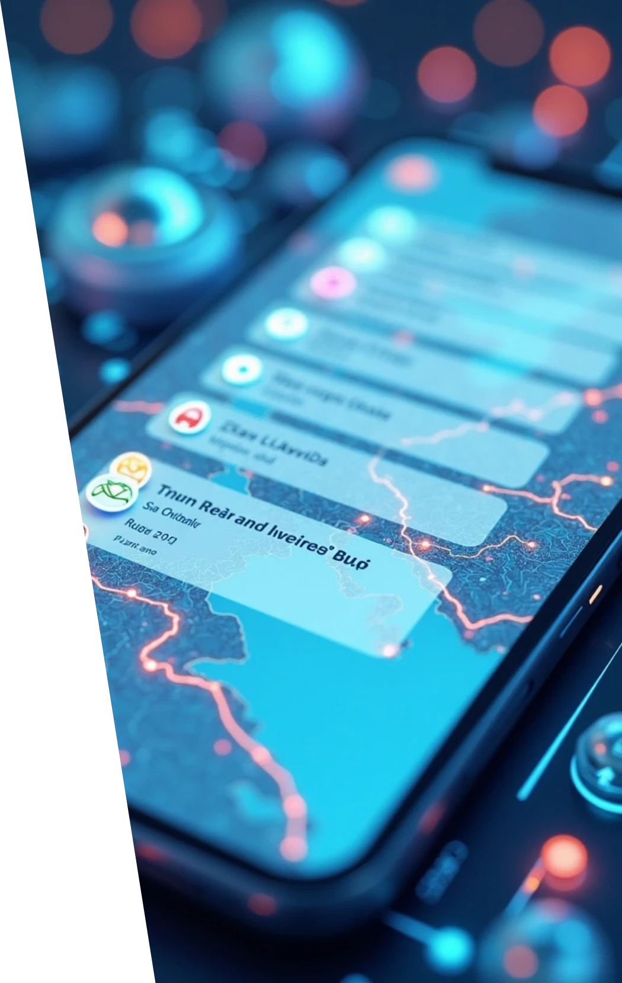

List of Features
AI-based destination & hotel recommendations.
Day-wise itinerary generation with maps & timings.
Real-time budget optimization.
Chatbot travel assistant (Dialogflow + Gemini API).
Option to book directly via EaseMyTrip.
Smart notifications (weather, flight updates, delays).

Slide 11

05
Project Documentation

Slide 12

Process Flow Diagram or Use-case Diagram

Slide 13

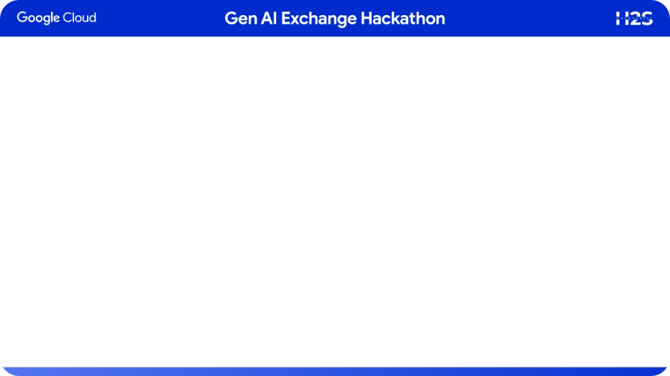
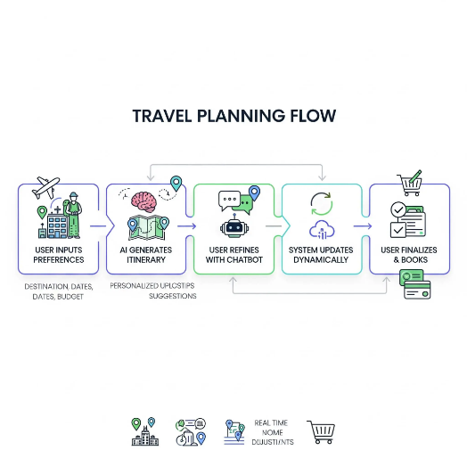
Wireframes/Mock Diagrams of the Proposed Solution

Slide 14

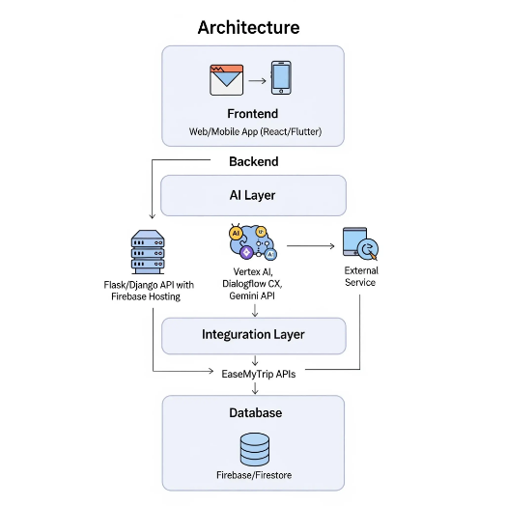
Architecture Diagram of the Proposed Solution

Slide 15

06
Technologies Used in the Solution

Slide 16




Technology Stack
AI/ML
Conversational AI
Frontend
Google Cloud Vertex AI, Gemini API.
React (web), Flutter (mobile).
Dialogflow CX.
Backend
Database
APIs
Python (Flask/Django) + Firebase Hosting.
Firestore / Cloud SQL.
Google Maps, EaseMyTrip API.
DevOps
GitHub, Cloud Run, CI/CD.

Slide 17
07
Implementation Cost Estimate

Slide 18


Cost Overview
Cloud compute & APIs: $200–$500/month (scalable).
Development effort: 8–12 weeks prototype build.
MVP hosting: Free tier → $50/month on Firebase/Cloud Run.

Slide 19

08
Additional Requirements for the Hackathon

Slide 20


Required Elements
Prototype Video: 2–3 min demo (screen recording with narration).
GitHub Repo: Codebase + README.
MVP Link: Deployed prototype (even partial).
Google Cloud AI Integration: Must be shown clearly in demo.

Slide 21

Thank You

